Slide 1
Cloud Capacity

Slide 2
Optimizing a Dynamic System
Firm requirements change continually in competitive markets
Dynamic customer behavior also changes cloud capacity modeling and planning
Corporate workflow resource utilization patterns may also change dynamically due to a wide variety of internal and external factors
Virtual Sprawl- Result of over capacity allocation of any virtualized infrastructure

Slide 3
Capacity Planning in Private Clouds
Enterprises running their IT infrastructure as a private cloud face even harder capacity management challenges.
Adding capacity means adding hardware, which must be cooled, connected, and protected
Capacity management is essentially a balancing act that ensures that the capacity and the performance of the IT services in an organization are utilized in a most cost effective and timely manner. These actions include
Balancing costs against resources needed
Balancing supply against demand
True for both public and private cloud

Slide 4
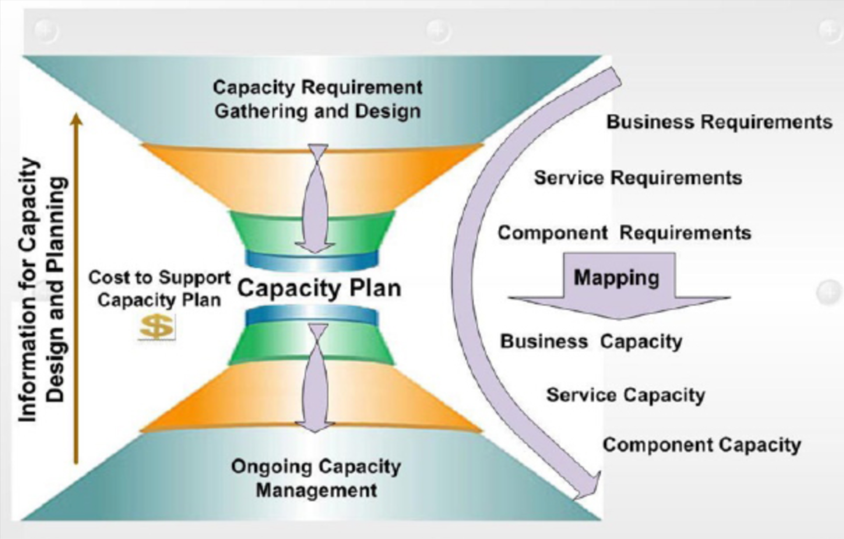

Slide 5
Cloud Capacity Planning 101
Initial budget prepared/provided
Size application to available hardware/software so least cost achieved.
Determine when capacity should be added. If added capacity is auto-provisioned by system, ensure constraints prevent excessive cost overages.
Ensure costs per business unit of work stay within the boundaries set by profitability.
Prevent unplanned expenses.
Determine the “practical capacity” , for each offered real or virtual system configuration, and instance type, where “practical capacity “ is defined as the range within which the SLAs are met.
Determine application scalability and when and where bottlenecks may emerge as demand increases.
Determine how much capacity is available for vertical scaling within each offered logical and physical configuration before another logical or physical instance must be added for horizontal scaling.
(Vertical = within an instance; horizontal = across instances)

Slide 6
Scale Up vs. Scale Out
Vertical Scaling (Scale-up): Generally refers to adding more processors and RAM, buying a more expensive and robust server.
Pros
Less power consumption than running multiple servers
Cooling costs are less than scaling horizontally
Generally less challenging to implement
Less licensing costs
Cons
PRICE
Greater risk of hardware failure causing bigger outages
Horizontal Scaling (Scale-out): Generally refers to adding more servers with less processors and RAM.This is usually cheaper overall and can theoretically scale infinitely
Pros
Much cheaper than scaling vertically
Easier to run fault-tolerance
Easy to upgrade
Cons
More licensing fees
Bigger footprint in the Data Center
Higher utility cost (Electricity and cooling)
Possible need for more networking equipment (switches/router)

Slide 7
Spin Up, but First Tear Down/Change
Before spinning up a new cloud application or service, cloud managers typically tear down an unused or inefficient process
Designing applications to use the minimum capacity and ideally to scale out rather than scale up.
They/YOU may repeat this process several times a day

Slide 8
Planning VM Capacities for a ‘job’ ( = User Request for a VM)
one virtual machine (VM) (or 10; or 100; or..)
with fixed size CPU cores (may add CPU cores)
RAM (may vary)
disk capacity (may vary)

Slide 9
VM Provisioning 101
If a request is accepted, it goes to a specific physical machine (PM) for VM provisioning
In public cloud, that PM is unknown to user
In private, known
In hybrid…maybe/maybe not
After getting the VM, the request runs in the cloud and releases the VM when it finishes

Slide 10
Life-cycle of a job inside a IaaS cloud
Provisioning response delay
Arrival
Queuing
^{Provisioning} Instantiation
VM
Actual Service
Out\
Decision
deployment
Resource Provisioning
Instance Creation
Deploy
Run-time Execution
Decision Engine
Admission control
Job rejection due to buffer full
Job rejection due to insufficient capacity
Provisioning and servicing steps:
resource provisioning decision,
VM provisioning and
run-time execution
Source: Rahul Ghosh, Duke U.

Slide 11
Before Virtual, a Physical Machine
Physical machines may be:
hot (running with VM instantiated)
warm (turned on but VM not instantiated) and/or
cold (turned off)

Slide 12
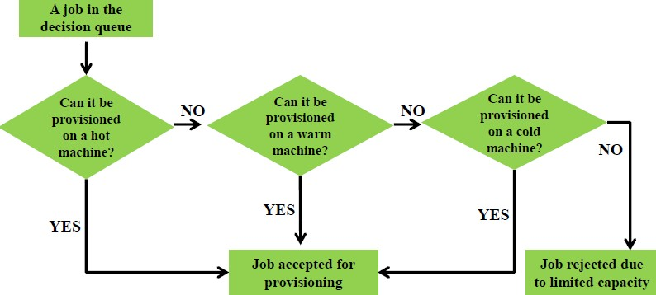
Resource provisioning decision
A request is provisioned on a hot PM if pre-instantiated but unassigned VM exists. If none exists, a PM from warm pool is used. If all warm machines are busy, a PM from cold pool is used.
Source: Rahul Ghosh, Duke U.

Slide 13
Cloud Capacity
Determine Capacity Requirements
Produce Capacity Plan
Management
Process 101
Design for Capacity
Tuning
Implement
Monitor
Analysis

Slide 14
Cloud Capacity & Service Qualities
Two key quality-of-service measures for IaaS cloud services:
service availability
provisioning response delay
(For 1 & 2: if you request an ‘available’ cloud service e.g. a Netflix show orYouTube video….and nothing happens, how do you feel?)
For 5 seconds..ok; for 10 seconds..annoying; for 15 seconds…time to switch to Amazon or Hulu?

Slide 15
Capacity Planning in Public, Private and Hybrid Clouds
How different?
How the same?

Slide 16
Cloud Costs
Upfront cost for reserving or booking instances
Cost of pay per use compute, storage and network resources
Cost of transactions (IOPS / GET / PUT). This is a cost that is not applicable in a private datacenter model and hence organizations need to look out for per transaction charges.
Network bandwidth cost (this can be substantially higher in a cloud scenario than traditional scenario)
Cost of migration to a cloud environment
Monitoring and management tools
Operations expenses
Software licenses
License migration costs (if applicable)
Applicable annual maintenance fees

Slide 17
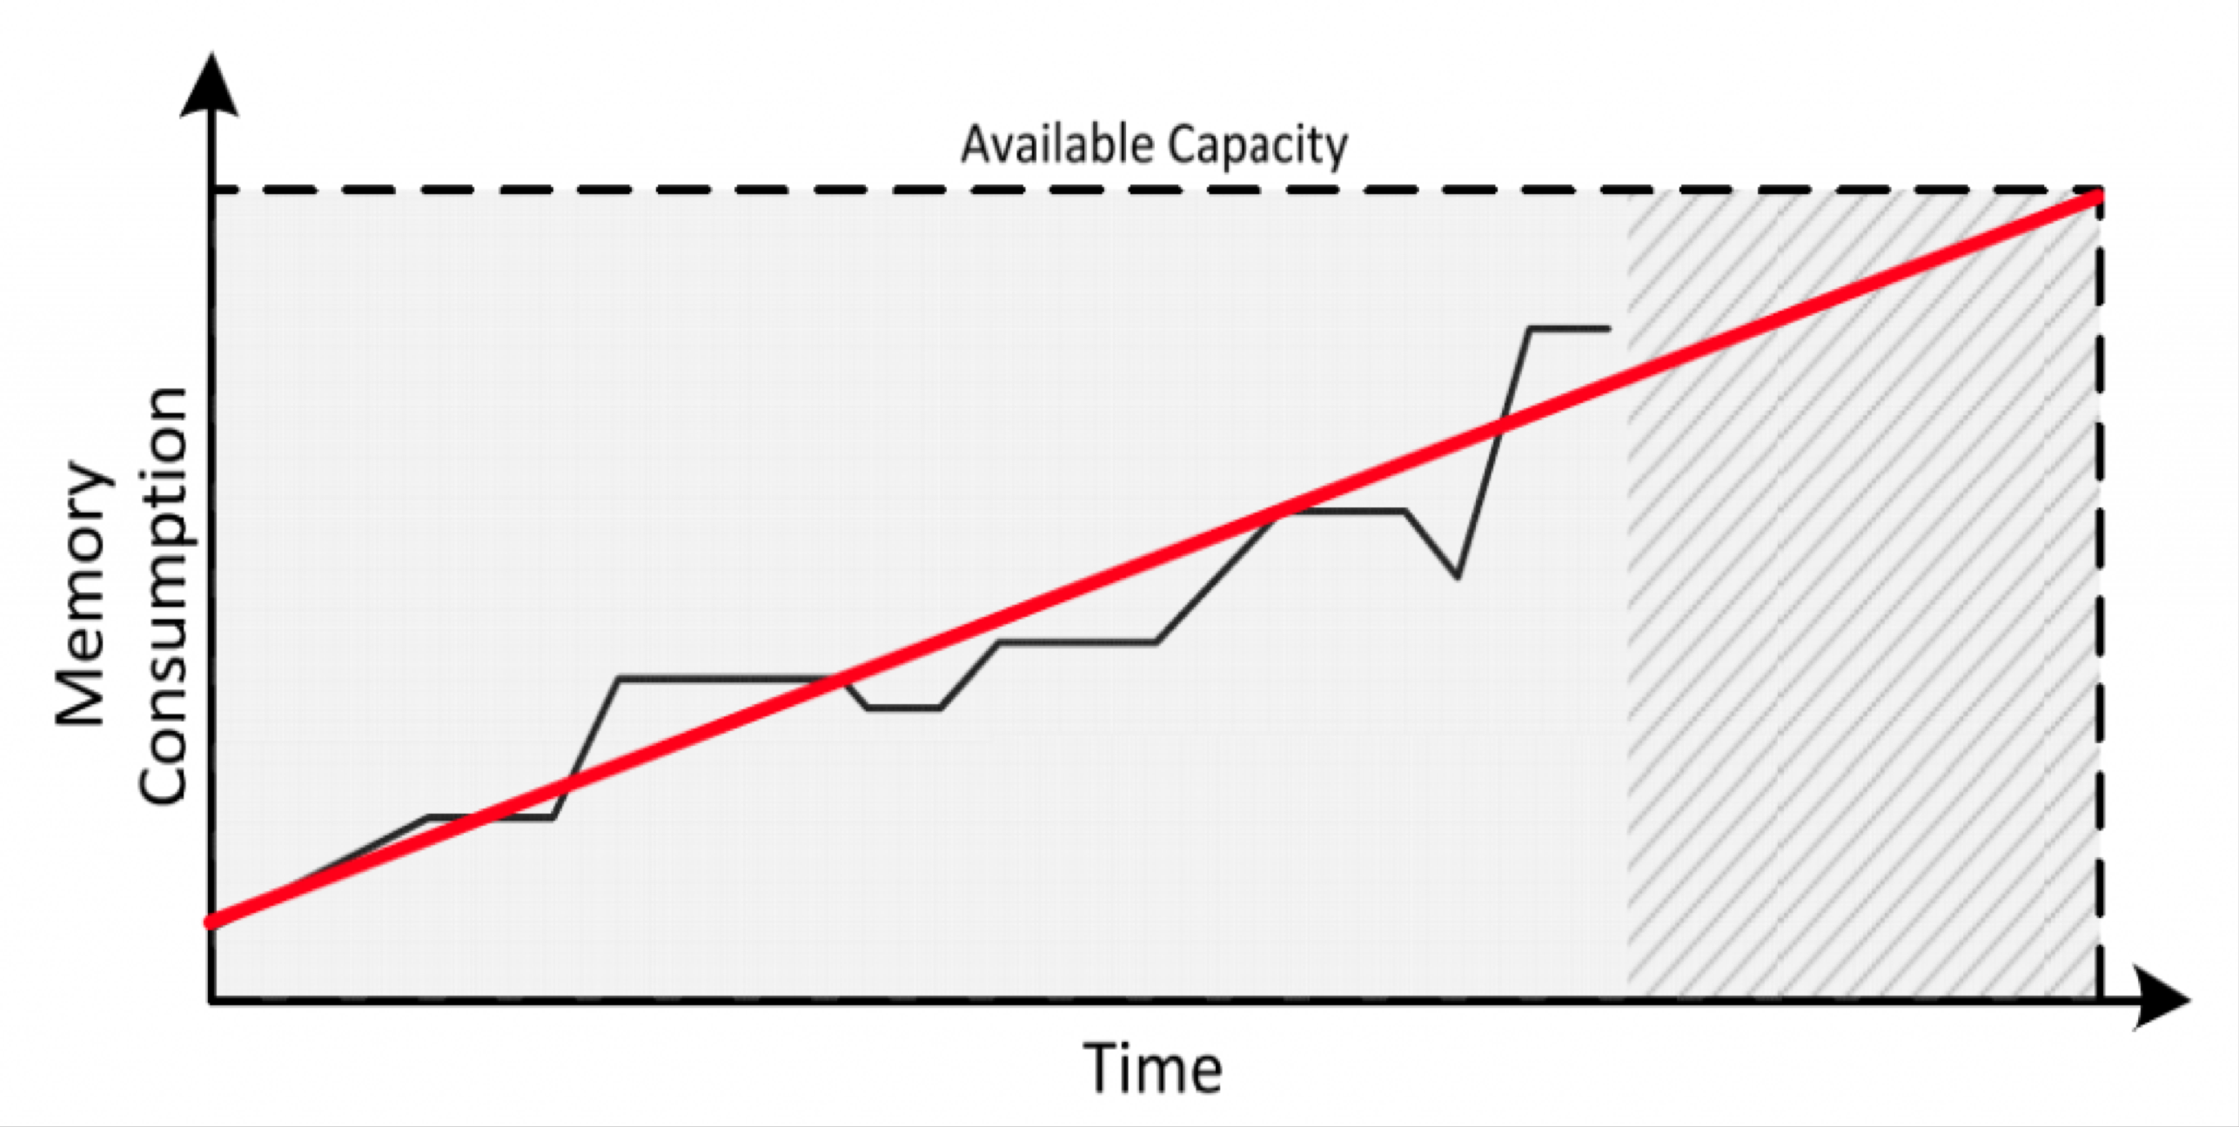
Plotting Capacity Consumption Trends over Time – Tools like vCenter Operations

Slide 18
Cloud Service Providers Capacity Management
Data Collection and Thresholds
Analysis of current and future usage if services
Roll ups of individual services which constitute the cloud service
Monitoring of SLAs (Service Level Agreements)
Workloads at various locations/data centers
Proactive and reactive actions to enhance capacity

Slide 19
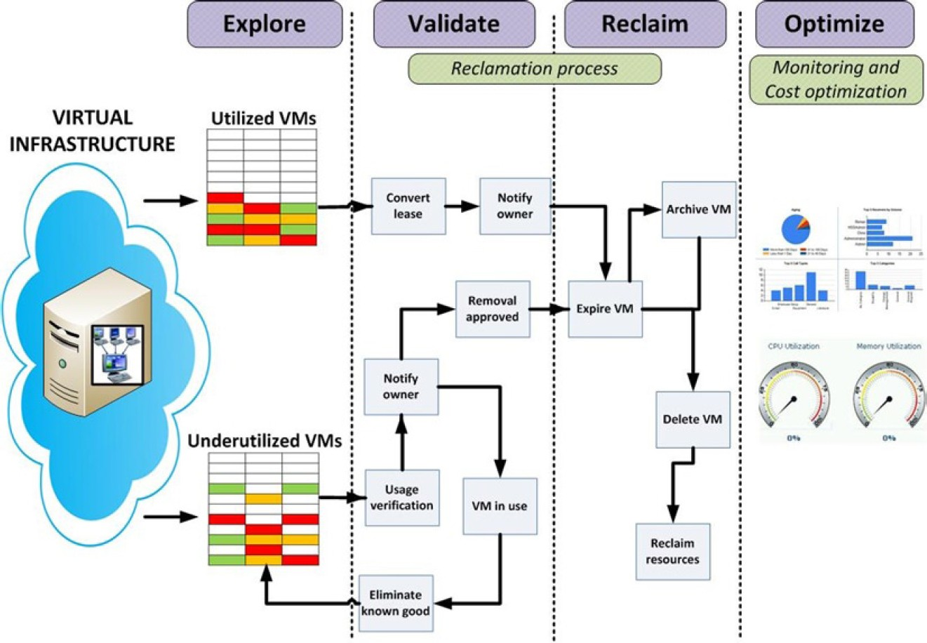
Virtual Sprawl

Slide 20
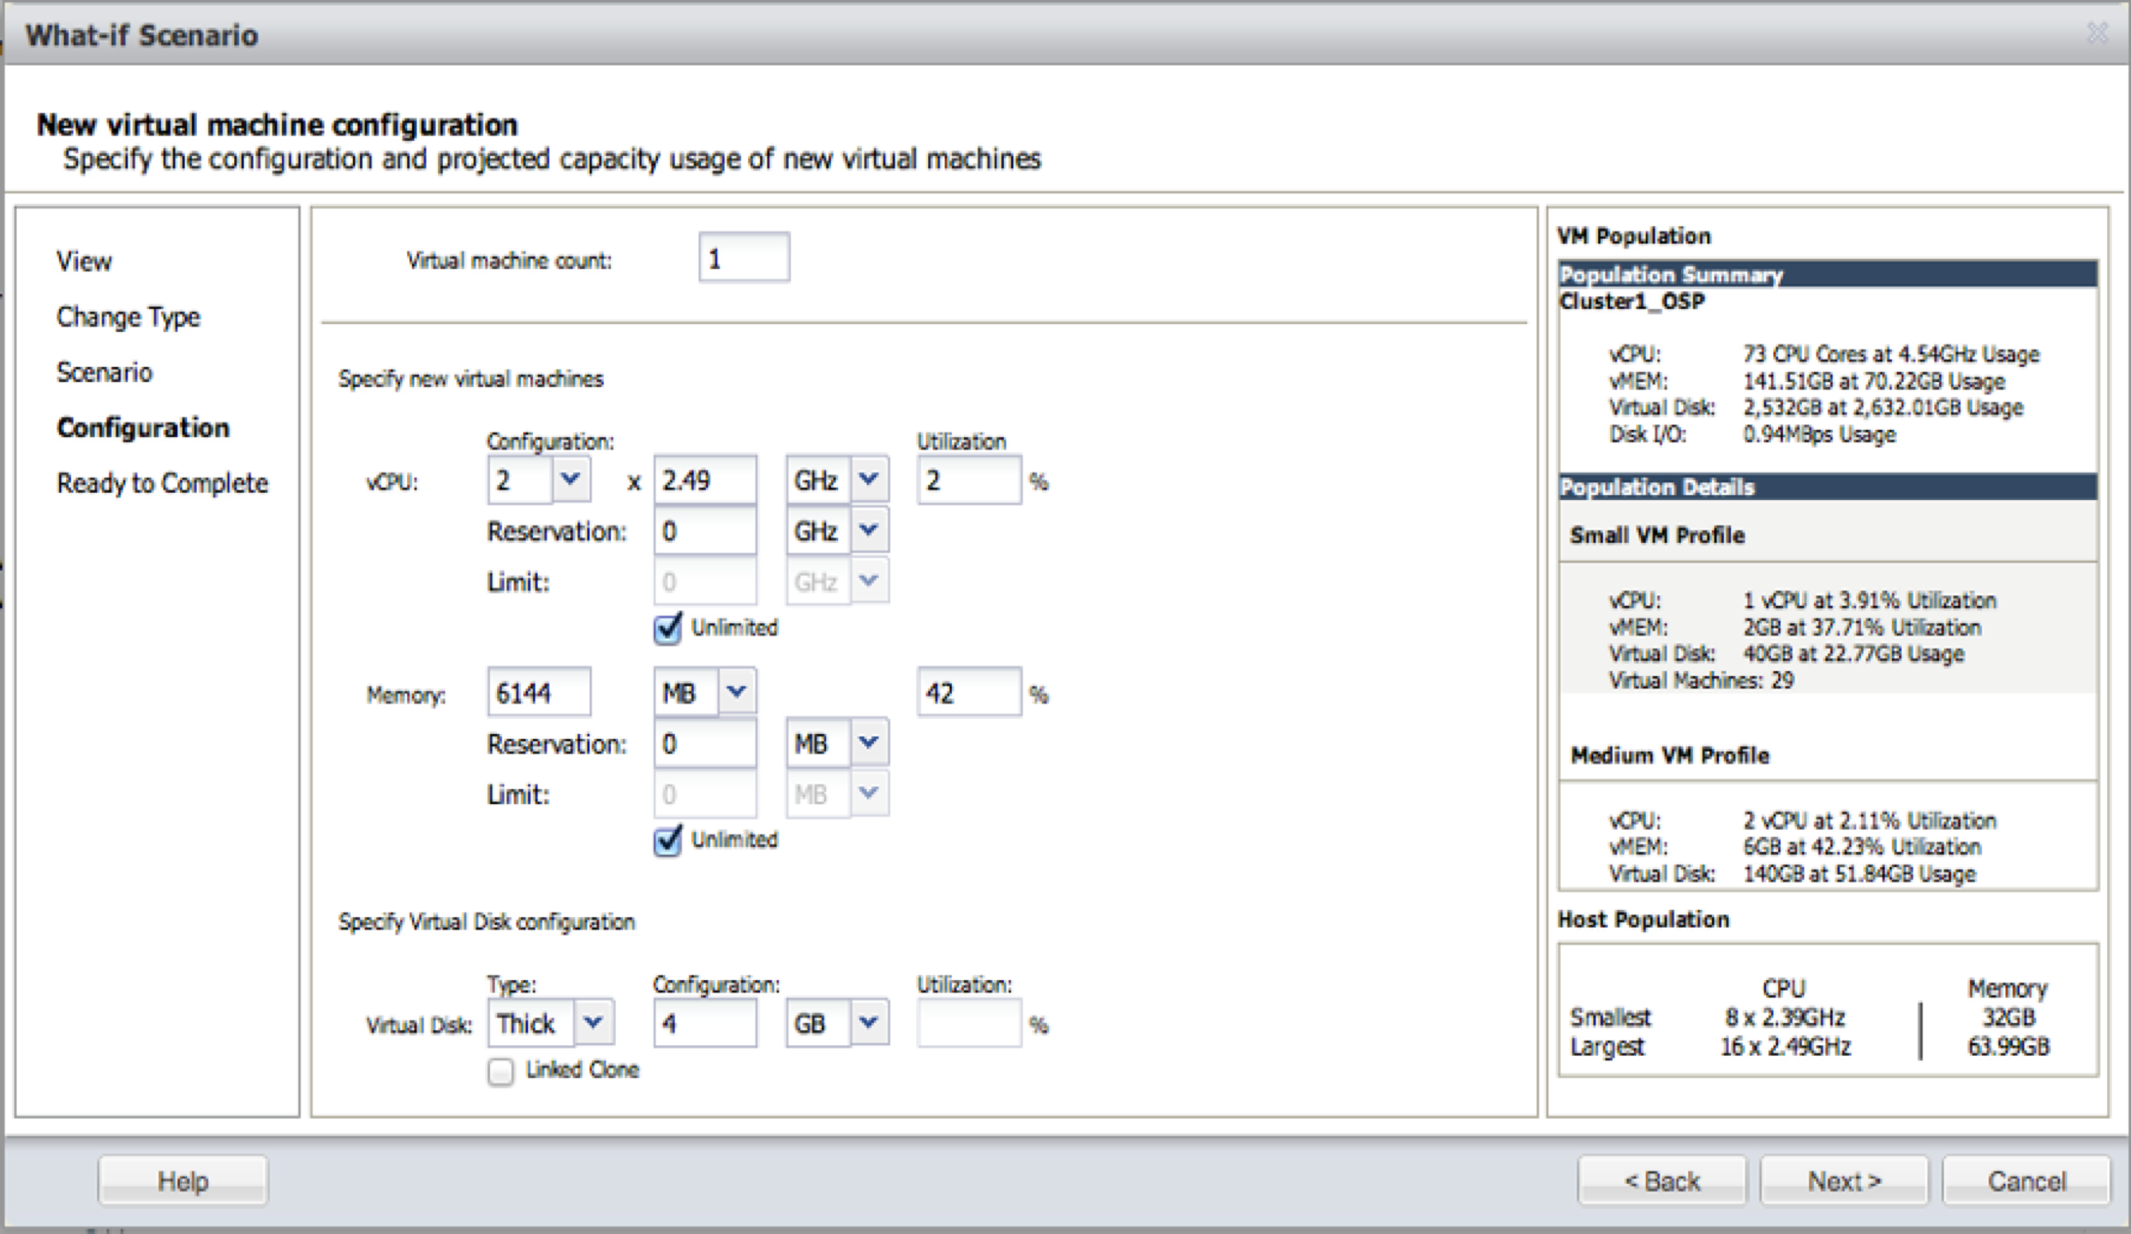
Capacity analytics of VRealize Suite
Capacity Analytics and Planning
Video Tutorial: https://www.youtube.com/watch?v=yvrL4mAjdEI

Slide 21
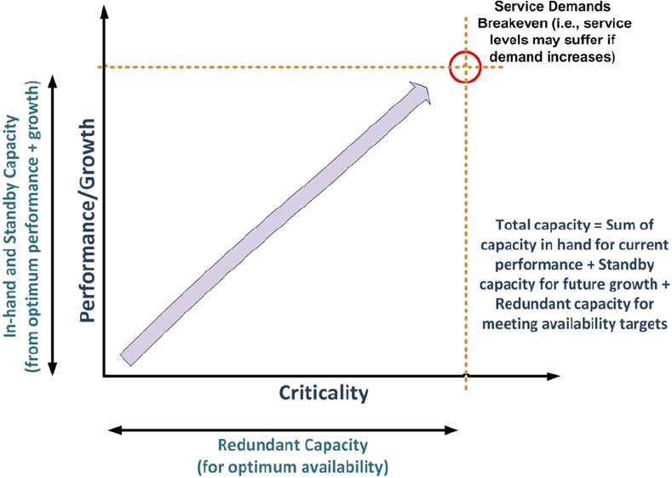

Slide 22
Various capacity definitions that can be considered may be:
Capacity in use: used for supporting the existing service levels
Standby capacity: required to fulfill the capacity-related needs of immediate peaks and troughs, and also for any failures that may occur in the capacity in use.
Redundant capacity: overall capacity inventory, which is maintained as per business continuity planning, service demand, service portfolio management, and other long term inputs for strategic capacity planning purposes. The redundant capacity is what is available for future expansion of the current workloads.
For a cloud service provider, overall capacity management and planning will revolve around seeking the optimum balance around these components— with total capacity to provide a cloud service being the sum of all components: capacity in use, standby capacity, and redundant capacity.
Business criticality, the importance of services to the business, must be interpreted
to see the unforeseen events leading to service outages;
proactive measures like redundancy, backup, recovery,
failover must stand firm against any downtime challenge.

Slide 23
Capacity management procedures must be able to clearly formulate uptime requirements in terms of data center tiers organized by business criticality, performance requirements, and the growth plan.
Capacity management procedures must keep an eye on demand and business growth plans to ensure that demand is met by standby capacity and is able to support continued service levels.
Total service requirements can be driven from performance requirements, future growth needs, and business criticality of the service.

Slide 24
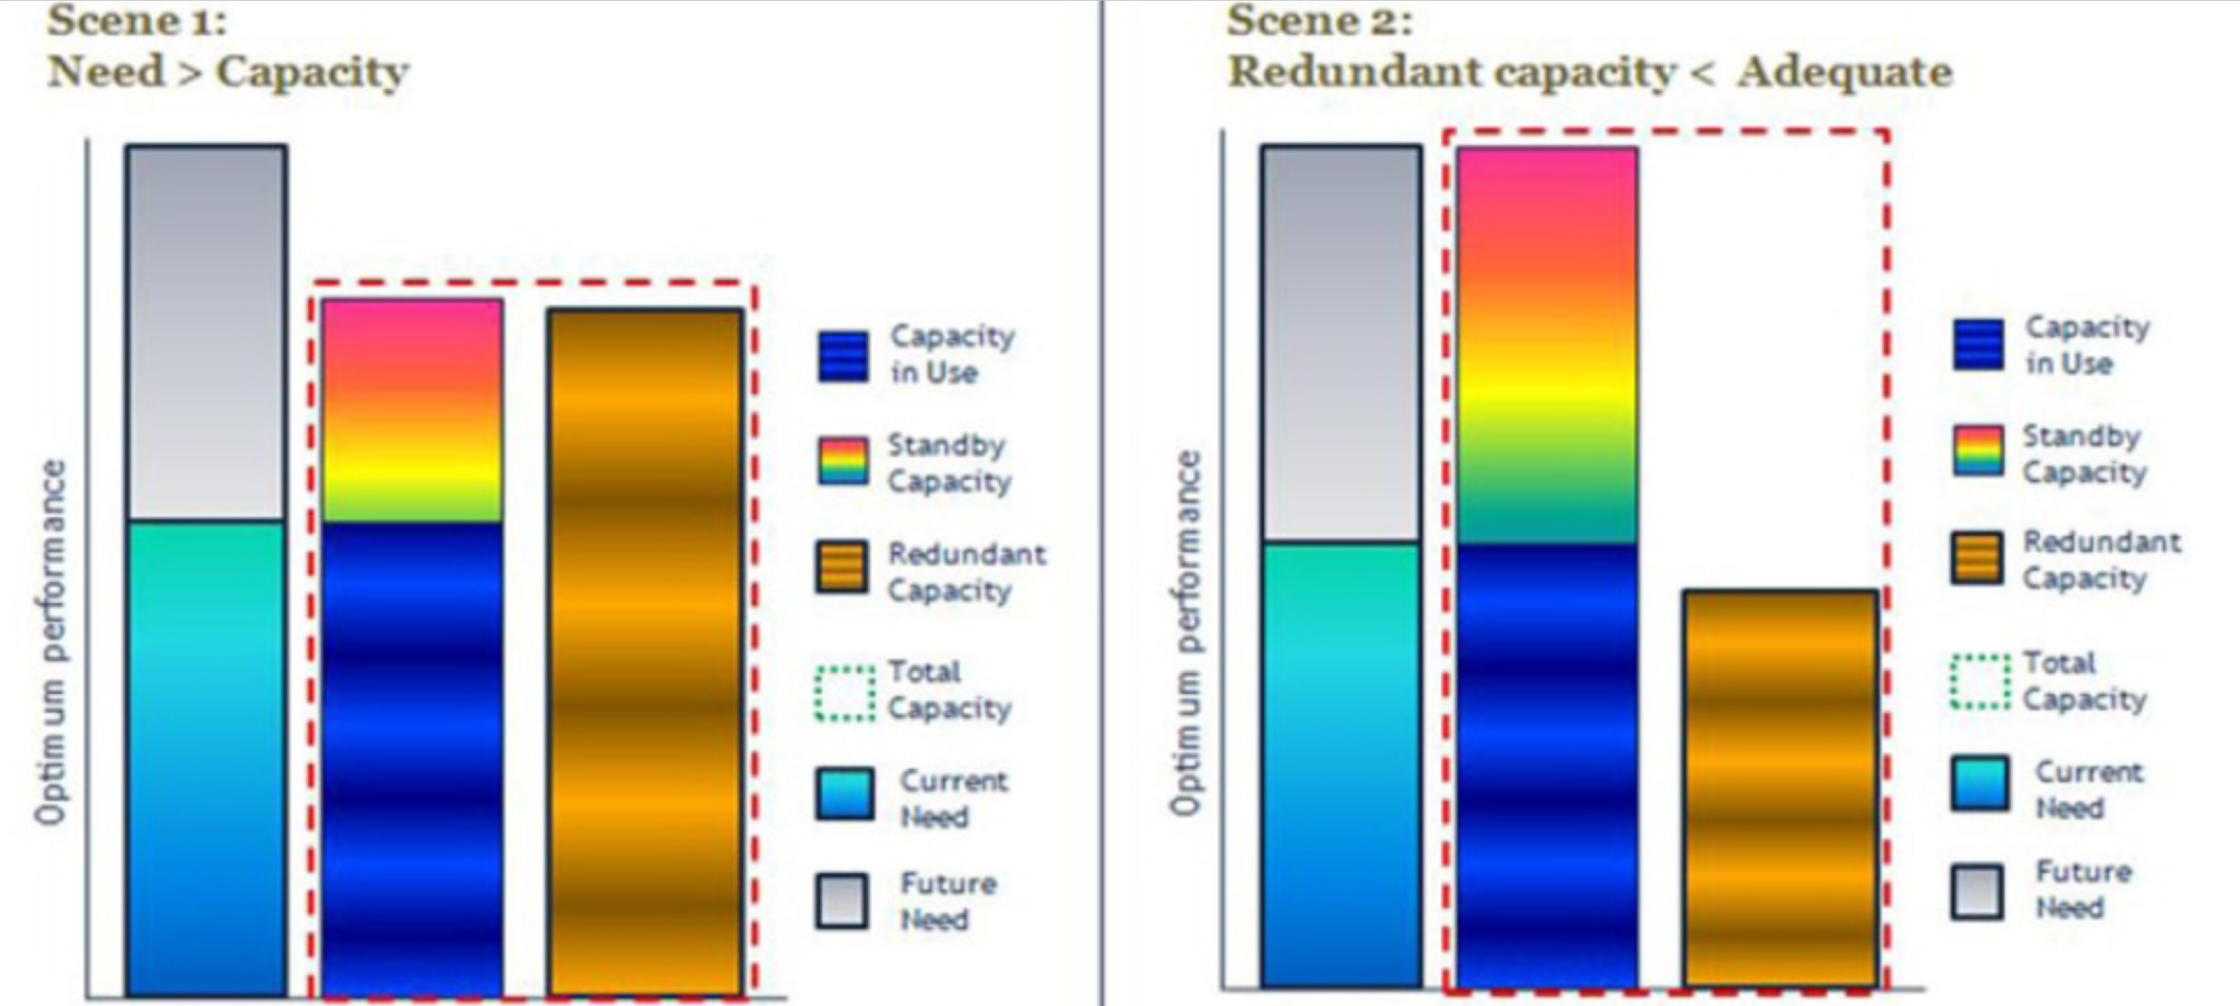
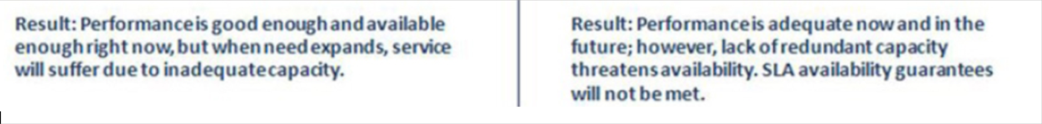

Slide 25
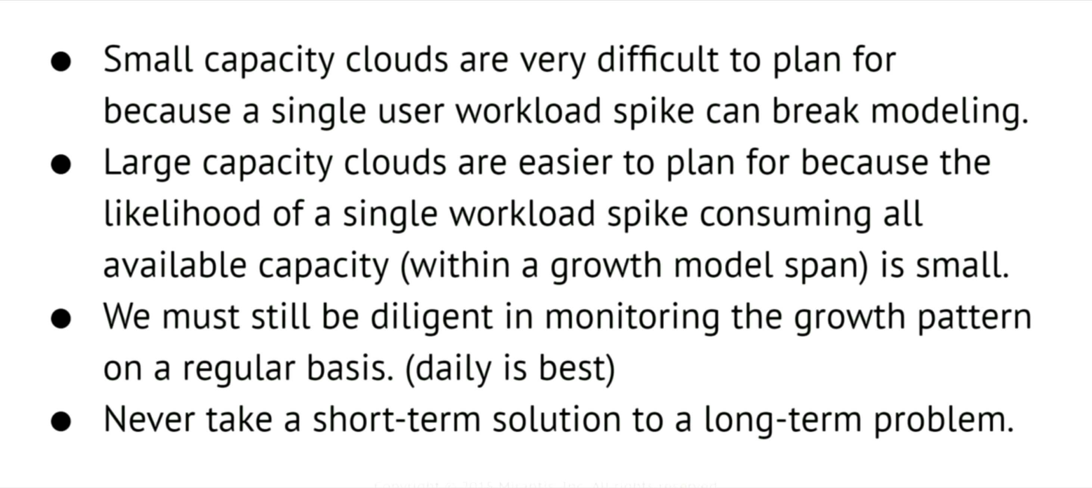

Slide 26
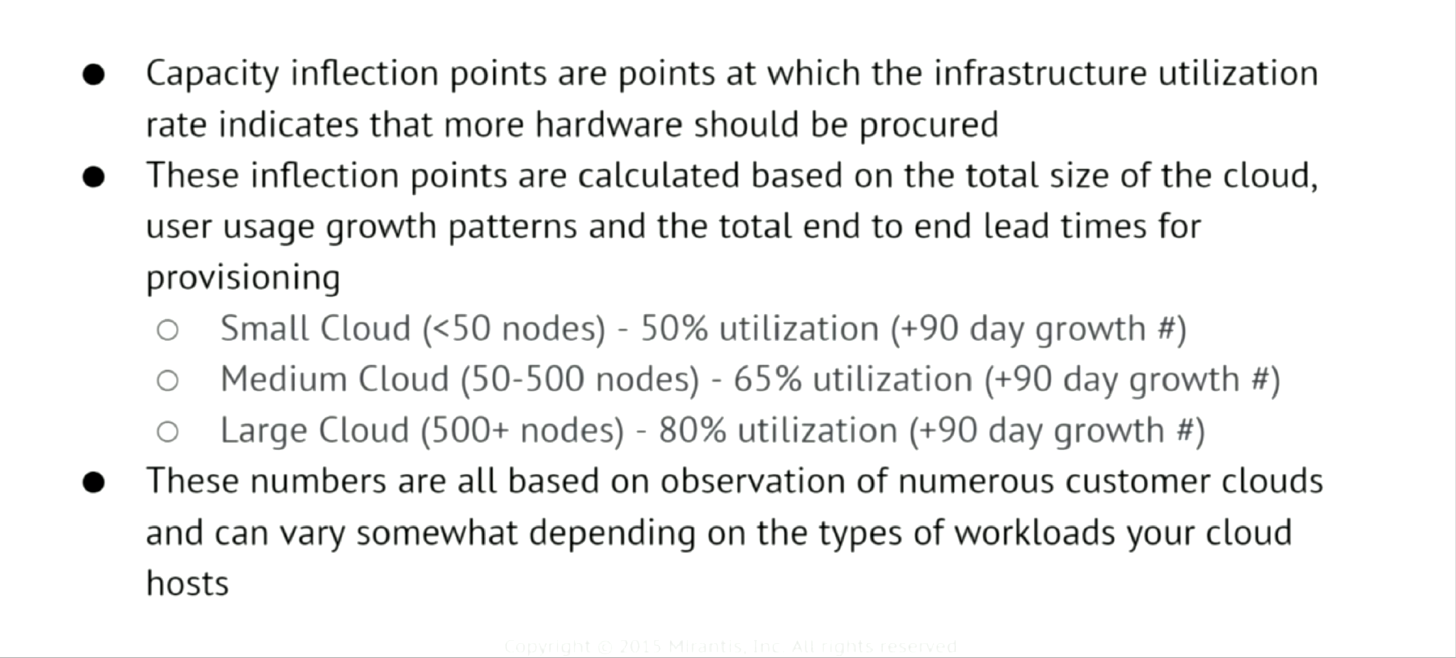
Inflection Points

Slide 27
Questions?

